Slide 1
INNOVATION MANAGEMENT SYSTEM
Name :SASIKUMAR E
Department :AGRICULTURAL ENGINEERING
REG.NO:7376232AG146

Slide 2
PROBLEM STATEMENT
In many organizations and institutions, innovative ideas are often shared informally through emails, meetings, or paper-based methods. This leads to issues such as lack of proper documentation, difficulty in tracking ideas, limited collaboration, delayed evaluation, and absence of transparency in the idea selection process. As the number of ideas and participants increases, managing and evaluating them efficiently becomes challenging.

Slide 3
Literature Survey
Problem & Need: Many businesses still use manual inventory methods like spreadsheets, which are error-prone, non-scalable, and inefficient for multi-branch operations.
Proposed Solution: A modern inventory management system was developed using the MERN stack to provide real-time tracking, automation, and centralized control across multiple branches.
Implementation & Collaboration: Backend was developed using Node.js with MongoDB and tested via Postman, while the frontend was built using React.js; GitHub was used for version control and team collaboration.
Reference: https://www.theseus.fi/handle/10024/873889

Slide 4
TECHNOLOGY STACK
Frontend
• React.js – Ideal for single-page applications Used for building responsive forms, tables, and dashboards for user interaction.
• Bootstrap – Provides pre-designed responsive components.
CSS - Used for styling and layout of web pages
Javascript - Enables dynamic and interactive behavior on web pages

Slide 5
Backend :
• Node.js – Runtime environment for executing server-side code.
• Express.js – Web framework for routing and exposing RESTful APIs for data handling, authentication.
Database :
• MongoDB – A NoSQL database used to store user accounts, sustainability logs, and configuration values. Easy to modify data structure without affecting existing data
Security :
• JSON Web Tokens (JWT) – Secure session management and Role-Based Access Control (RBAC).

Slide 6
SYSTEM ARCHITECTURE
User
Browser (Frontend UI)
REST API (Axios)
Node.js + Express (Backend server)
Routes(Auth, Users, Ideas , challenges)
MongoDB (Database)

Slide 7
Database Schema & ER DIAGRAM
Admin
USER _id: ObjectId, name: String, email: String, role: String, department: String, isActive: Boolean, createdAt: Date, lastLogin: Date }
Challenges
_id: ObjectId, title: String, description: String, startDate: Date, endDate: Date, createdBy: String, status: String, tags: String, createdat: Date, updatedAt: Date
Creates
(reviewer)
IDEA
_id: ObjectId, ChallengeId: String, title: String, solution: String, filename: String, path: String, submittedBy: String, status: String, Likes: Number, feedback: String, Comment: Array, createdByAt: Date, updatedAt: Date
Approve
(Reviewer)
Submit
(Employee)

Slide 8
WORK FLOW
Challenges
Dashboard
Approve/
Reject Ideas
Reviewer
Dashboard
Idea Creation
Employee
Login
Ideas Submitted
Approved Ideas
Admin
Dashboard
Ideas
Challenges
User Management

Slide 9
Limitations of Existing Projects :
Ideas for Random Problems: Most platforms allow users to submit ideas for any topic.
Complex User Interface: Many systems are cluttered with too many features.
Not Specific to the Company: Existing platforms are generic.
Uniqueness of My Project:
Simple User Interface: Easy to submit ideas and view challenges
Ideas Mapped to Specific Problems: Users submit ideas only for pre-defined challenges.
Role-Based Authorization: Different roles with different permissions like admin , employee , reviewer.

Slide 10
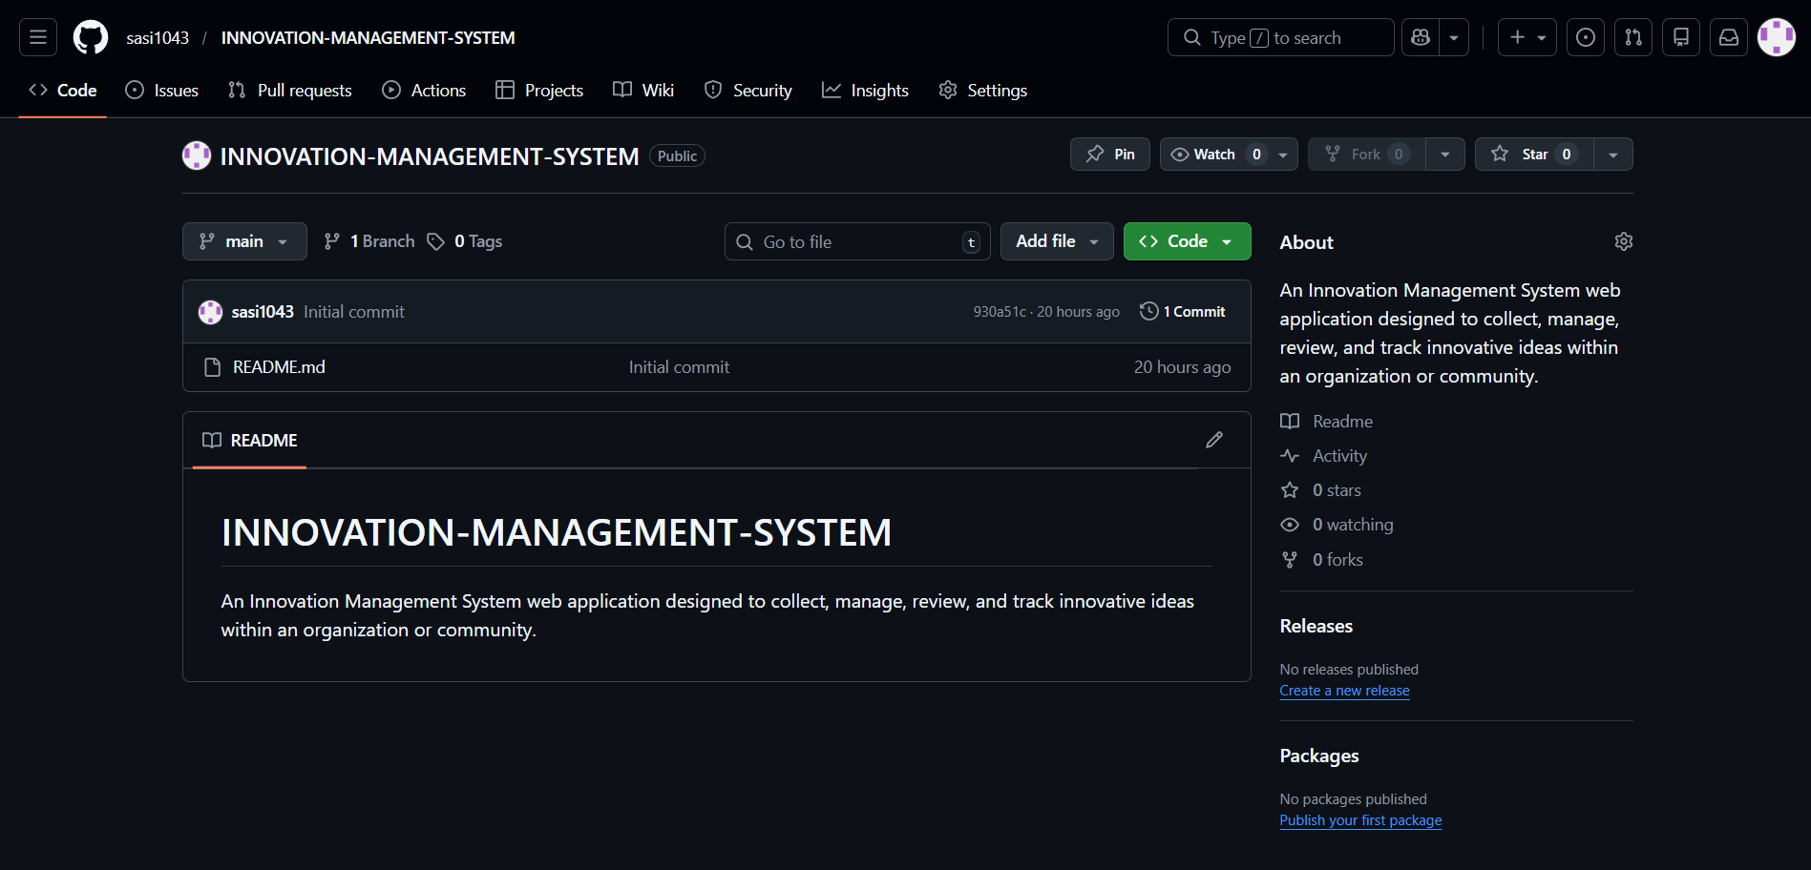
Github Repository:

Slide 11
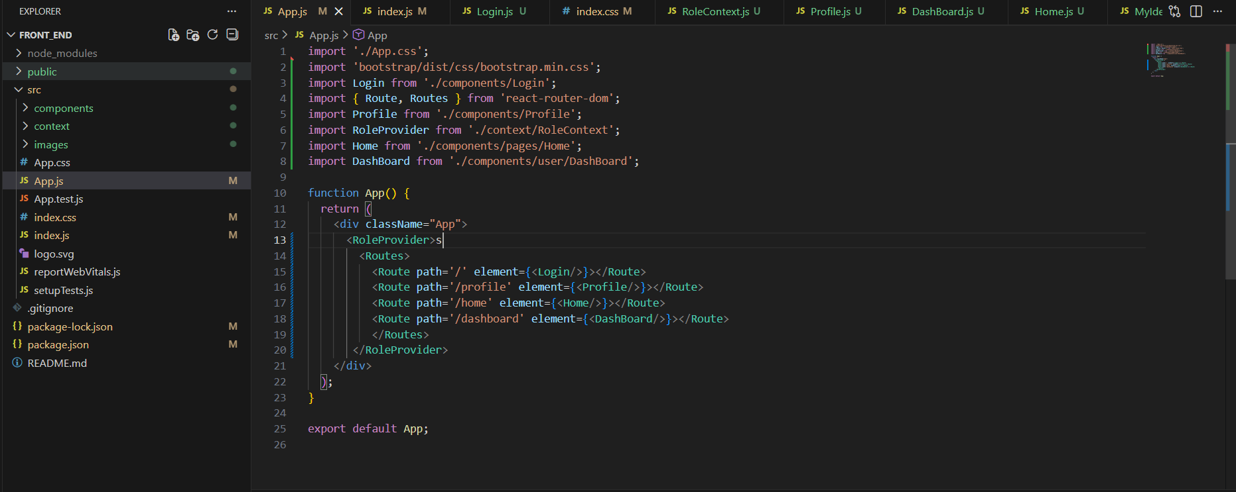
File Structure : Frontend

Slide 12
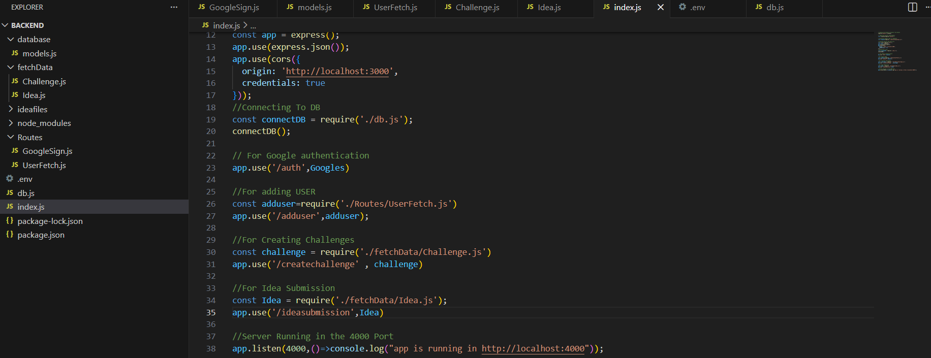
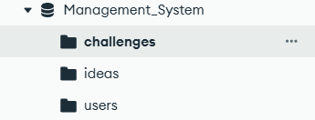
File Structure : Backend
Server :
MongoDB Schema:

Slide 13
Thankyou

